Slide 1

Marketing cloud for Marketing Retention
We are a one-stop-shop to automate your marketing and manage your retention and relation by optimising all the channels of communication, using deep data segmentation and personalisation

Slide 2
01
What do we do?
02
How it works?
03
Why choose us?
04
Testimonial
05
Our Pitch
06
Objective
07
What we do for our Online Trading Companies?
08
Customer Lifecycle
Consideration
Evaluation
Fund Account Opening
Experience & Transactions
Retention
Advocacy

Slide 3


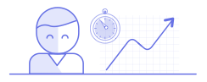

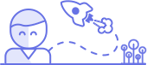
What Do We Do?
We manage your customer engagement and retention across multiple channels, making marketing automation simple.
The four key things that we facilitate for our customers are:
Live Segmentation
Cross-channel Communication
Deep Data Personalisation
Real-time Analytics
Group users into meaningful segments. Create real-time, dynamic and rolling segments based on user attribute and their behaviour across multiple channels.
Drive retention via triggered campaigns across Email, Push, In-App, Web, SMS, Web Push. Create coherent messaging by targeting users' cross-channel profiling.
Create a comprehensive user profile by merging user attribute data, transactional data and business data pulled via api. Engage users through highly personalised campaigns.
Get access to real-time multi-channel campaign analytics. Improve your offering with actionable insights on how users engage with your product and what gets them back.

Slide 4


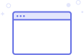
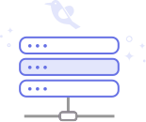



How It Works?
Here is a quick overview of how our system seamlessly integrates into yours and engagement begins. WebEngage can integrate with all your customer touch points and collect feedback from your customers through cross channel marketing automation.
Apps
Websites
DMP
Segments
Engagement Channels
Data Warehouse
(Data Management Platform)
The WebEngage Data Management Platform (DMP) stores your data in real time to create meaningful segments and personalised communication.
Segment users based on user attributes, events, event attributes and technology, to create granular segments. Robust analytics to tweak campaigns for the best ROI.
WebEngage drives your marketing by allowing triggered communication through Email, Push, In-App, Web, SMS, Web Push. You can also engage with your users on Multi-Channel Lifecycle campaigns with Journey Designer.
Our SDKs integrate with your App or Website and profile your users and events in real time. You can also transfer your data on our DMP via REST APIs or by uploading CSVs.

Slide 5
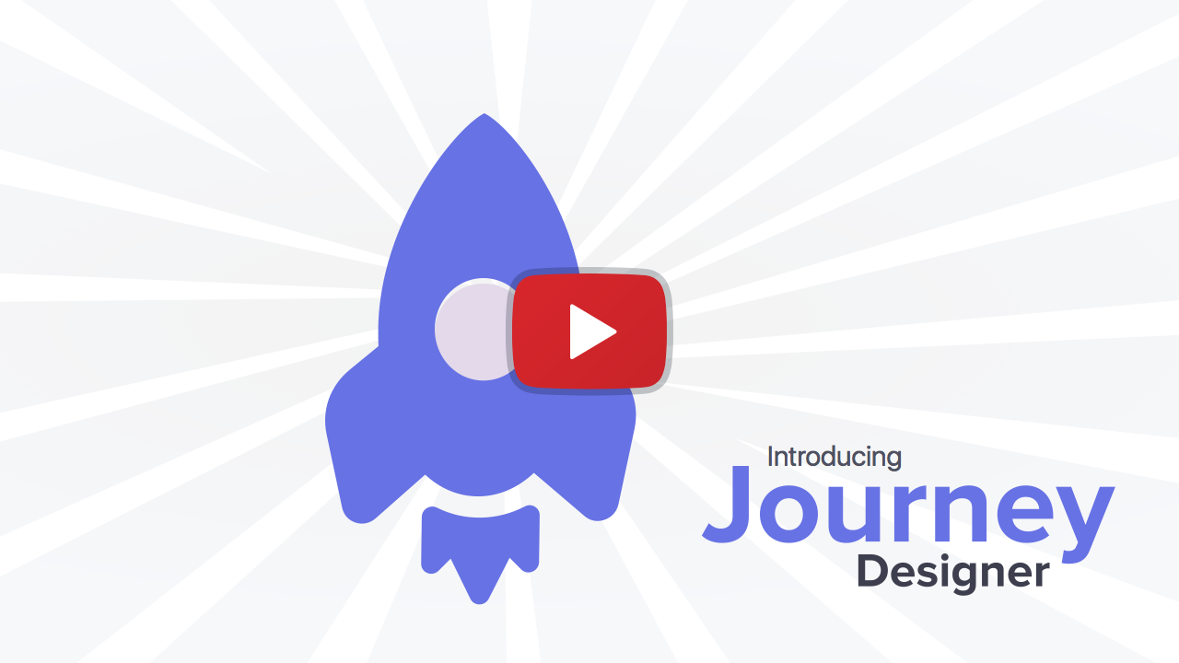
Why Choose Us?
Journey Designer
Analytics Engine
Enabling Product Communication
We are Built for Scale
Journey Designer - Our Key Strength
Put your marketing on auto-pilot by visually plotting customer journeys using a drag-n-drop workflow builder. Spend more time optimising your marketing strategy and less time on execution.
Journey Designer, makes us a unique suite. Check out this quick 2-minute explainer video.
To know more about Journey Designer, click here.

Slide 6
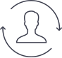






Why Choose Us?
Journey Designer
Analytics Engine
Enabling Product Communication
We are Built for Scale
With WebEngage Analytics Engine, you can get more insights of your existing user base so that you can build your right engagement strategy.
User Insights
Get deep insights into your entire user base, known as well as unknown, and analyse them from many different perspectives
Event Insights
Analyse what’s actually happening on your website/app and who is performing those events. These could be custom events you’re sending to WebEngage such as “Searched”, “Checkout Completed” etc. or system events that WebEngage automatically gleans such as “App Installed”, “App Upgraded” etc.
Dynamic Segments
Create real-time segments and make effective decisions by understanding your users and how you engage with them
Channel & Campaign Insights
Get unprecedented insights into the various channels of engagement and the campaigns created on those channels
Engagement Overview
Understand how much have you been engaging your users across different channels and compare the performance of the various channels
User Funnels
Identify the specific points in your product where your users drop-off, and get insights from both a campaign as well as product perspective
Cohort Analysis
Understand the retention pattern of different cohorts over a period of time, based on the actions performed

Slide 7




Why Choose Us?
Journey Designer
Analytics Engine
Enabling Product Communication
We are Built for Scale
With WebEngage you can easily stitch real-time consumer behavioural data from your website and mobile apps with data from your product catalogue, data warehouse, third-party data stores to make it actionable.
Abstract your Product and Marketing Messaging
Easily configure the logic and rules to trigger your product and marketing communication without the dependency on your Tech team
Send Communication until Read
With Cross Channel communication reach out to your customers until they have read your message
Target using your Bi systems, engage using Ours
Sync your BI segmentation logic with our systems directly and engage with your users through our platform
Ingest offline events using Api/batch upload
Sync all events that occur outside the website or app with relation to a particular user via API or batch upload
Run on-the-fly experiments - measure impact - adapt in real time
We help you run control groups, run multi variate tests and measure conversions within a single dashboard. After the initial set up, spend your time on optimisation

Slide 8









Why Choose Us?
Journey Designer
Analytics Engine
Enabling Product Communication
We are Built for Scale
WebEngage Is Here To Cater To All Your Needs For Today And Even For Future When Your Business Scales Multiple Folds.
45000+
50+
270 Million+
Happy customers
Countries
Users engaged monthly
125 Million+
4 Billion+
Messages per month
Events per month
Trusted By

Slide 9
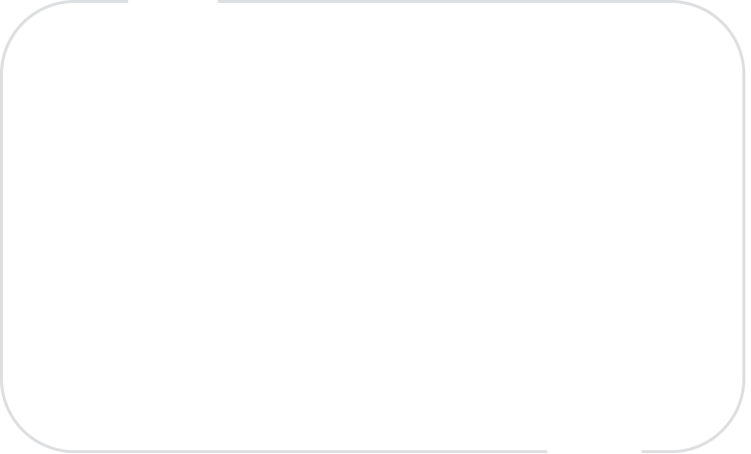

“
Thanks to the awesome team at WebEngage for their support, tech & responsiveness. we ourselves never imagined that we will end up sending about 7,000 different e-mail templates.
Santosh Navlani
Senior VP & Head, eBusiness, DSP BlackRock
“

Slide 10

Our Pitch For the Online Trading & Investment Business
Based on our research, inference and experience we have mapped various stages of a user’s lifecycle with respect to the Online Trading Business. In each of the stage; right from potential investors browsing the website & app, to investors who have not completed the online trading, to reviving investors who have not traded for quite some time, we have identified some key problems and recommended solutions for the same.

Slide 11
Objective
Engage with the users at the right time by sending them relevant content and offers for various services across multiple channels based on their interaction with the Broker so that the user eventually trades online from the app or website.

Slide 12
Online Trading & Investment Lead Engagement for New Users

Slide 13
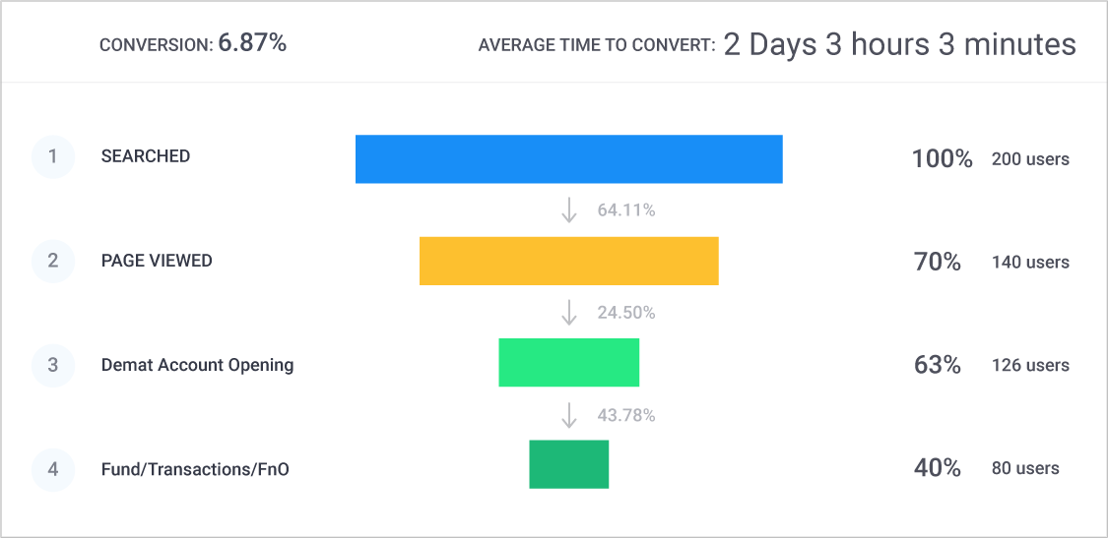
What we do for our Online Trading & Investment Clients?
Address Funnel Drop-offs
Increase Lead Conversion
Track user activity and personalise communication
Reduce Funnel Drop-Offs
Based on drop-offs from different stages of the user journey funnel, WebEngage is able to analyse user’s behaviour across platforms and create lifecycle journeys such as: Welcome Journeys, Buy-Sell Journeys, Individual Trading Style & Need Journeys among many others, to address these issues. Read more about our new Funnels feature here
Hey Ravi, Build a Prosperous Circle . ABC brings a hassle-free investing experience for your family & friends with 3 easy steps to start smart investing
Bounce
Bounce
Congratulations! You can open a free demat account with flat 20% brokerage discount and start trading in 1 hour
Bounce
Practice Trading with our Online Trade Simulator and choose the Low-Risk High Reward Trading Method

Slide 14

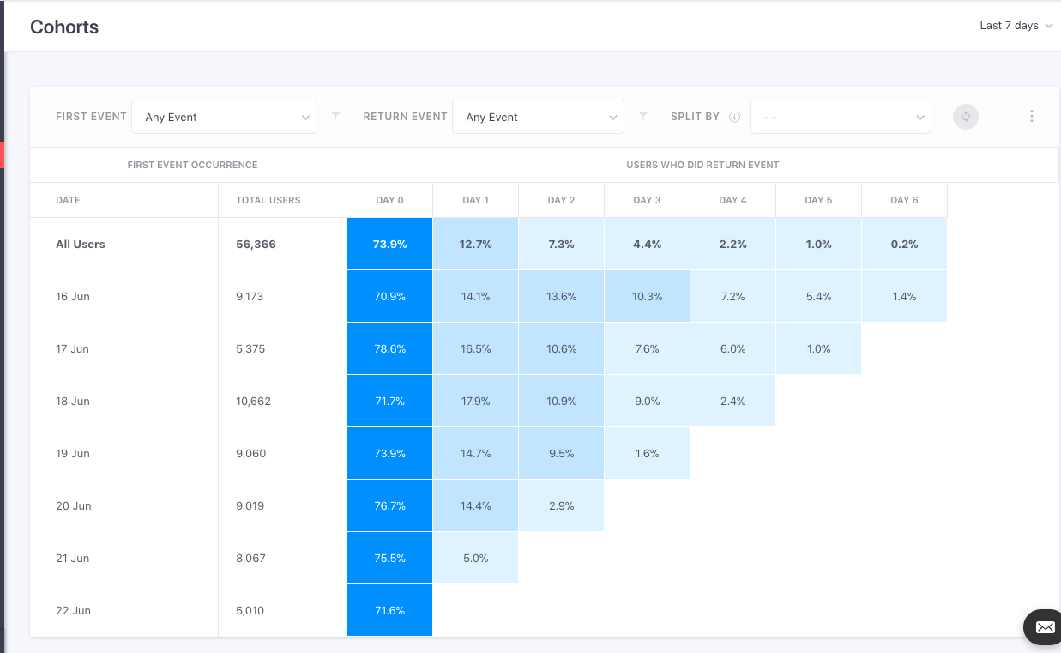
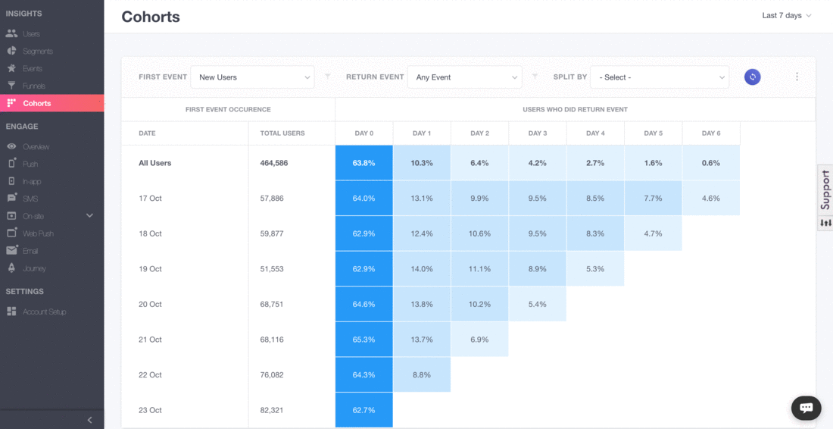
What we do for our Online Trading & Investment Clients?
Address Funnel Drop-offs
Increase Lead Conversion
Track user activity and personalise communication
Improve Repeat Transaction Rate
Once the customer has made their account opening, the next intention should be to get them to make a transaction, provide news, price and information and eventually make frequent transactions. With WebEngage you can run lifecycle campaigns that help improve 1st to 2nd transactions, 2nd to 3rd transaction and so on. Read more about our new Cohorts feature here

Slide 15

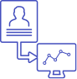

What we do for our Online Trading & Investment Clients?
Address Funnel Drop-offs
Increase Lead Conversion
Track user activity and personalise communication
Creating personalised campaigns for users who browse or Trade Online
One more important part of customer journey is sending relevant and personalised communication to the users. With WebEngage we help you abstract everything regarding that particular user behaviour which gets attributed to a unique User ID, and all online activity gets mapped to it directly which helps to send different communication for different reminders at the same time
Identifying each unknown Visitor as an individual user
aCCURATe Behavioural Mapping
Hyper personalised Communication
Everything regarding that particular user gets attributed to a unique User ID
Each user is assigned a unique identification (User ID), which is linked to the user’s online activity and other attributes
Create and send a highly targeted communication strategy which is deeply contextual and personalised.

Slide 16
Online Trading & Investment Lead Engagement for New Users

Slide 17




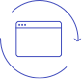
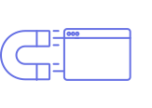
New Investors/ Traders Trade Lifecycle
Consideration
Evaluation
Fund Account Opening
Experience & Transactions
Retention
Advocacy
*Drop offs can occur at any stage between Awareness to Decision

Slide 18
Customer Lifecycle
Consideration
Evaluation
Fund Account Opening
Experience & Transactions
Retention
Advocacy
Problem
New User Activation
This is the first stage for a new user who may just be browsing for the best available trading options with brokerage benefit. Churn is the highest at this stage and if users do not leave their contact details, then getting them back to the website/app is difficult.
Goal
Increase Demat Account Opening process initiated, reach out to users who are looking for more information, get user to share some contact information.

Slide 19
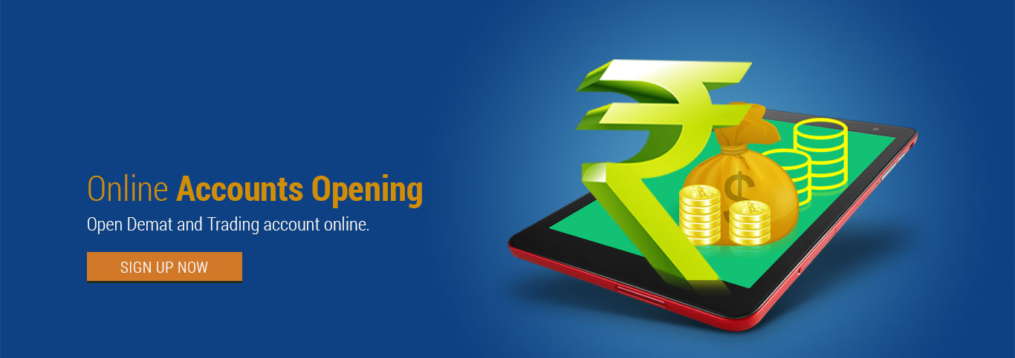



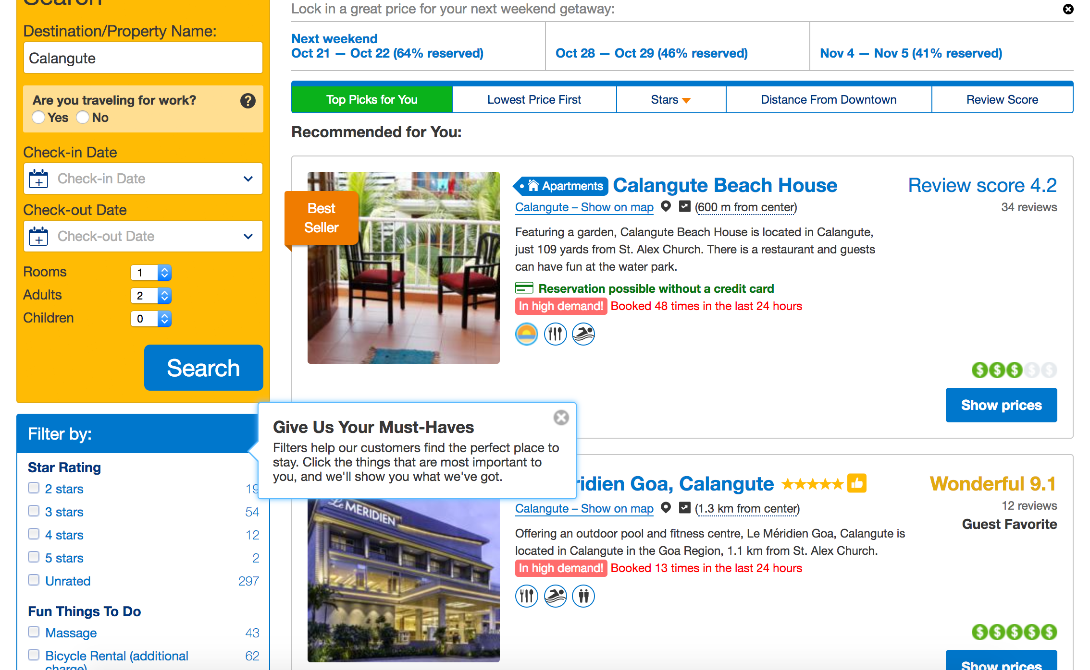

Customer Lifecycle
Consideration
Evaluation
Fund Account Opening
Experience & Transactions
Retention
Advocacy
Solution
Engage such users with notifications and surveys while they are on your website/app, to collect their contact details
Send them a request to send push notifications with updates and personalised offers.
Examples:
Would you like to get tips on smart trading and increase profits
Later
Allow
On Leave intent - "Hey, leaving already? Get the best trading tips personalised for you in your inbox. Share your email"
On-site Notification - “Couldn’t find what you were looking for? Tell us what you are looking for and our trading expert will help you” *Request for phone number*
Exclusive 20% Off
How about 20% off on brokerage? Enter your Email ID and we will send you the coupon code to your inbox!
Channel of Communication
— Web message - notification/ Survey, Web Push, Push Notifications
Email ID
Allow
Improvement Expected
~20%
Increase in New Users

Slide 20
Customer Lifecycle
Consideration
Evaluation
Fund Account Opening
Experience & Transactions
Retention
Advocacy
Problem
User May Consider other Competitors
At this stage, user comes back to the website and browses the services in detail. They spend more time checking out the listings but don’t eventually open an account.
Goal
Increase demat account initiated, reduce drop offs, improve user confidence and trust,

Slide 21
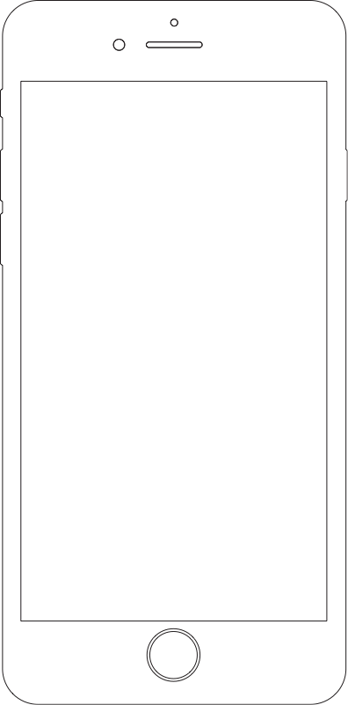
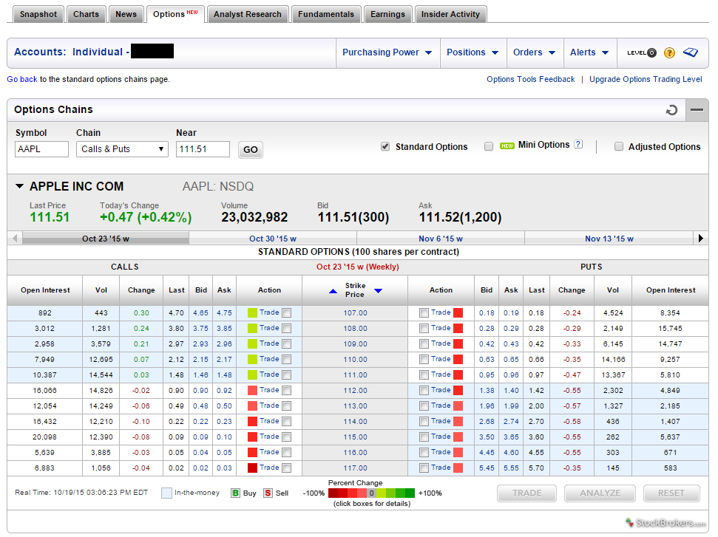
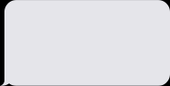
Customer Lifecycle
Consideration
Evaluation
Fund Account Opening
Experience & Transactions
Retention
Advocacy
Solution
Since the users have opted for push notification, engage with them using multiple channels of communication like web push, onsite, push notifications
Increase channels of communication, reach out when they are in an active session leading them to fill up contact details
Segment your users on the basis of their behaviour on your website/app to send them highly relevant and personalised communication over Email & SMS & Push
Include the last searched data in the communication and provide user with next (easy) steps so that they can open the account
Hey Ravi, still looking best trading platform?
Hey Ravi, open an account with code FB20 and get 20% brokerage discount! Hurry, offer valid for the next 2 hours.
11.30 AM
Use code FB20 and get 20% discount on brokerage in account opening!
Hurry, offer valid for next 2 hours
Channel of Communication
— Web message - notification/ Survey, Web Push, Push Notifications
Improvement Expected
~15%
Improvement in Conversions
Used the code and shared the contact details in last 24 hours

Slide 22
Customer Lifecycle
Consideration
Evaluation
Fund Account Opening
Experience & Transactions
Retention
Advocacy
Problem
Engaging With Your Customers (Account Opening)
At this stage, the user decides to finally open an demat account. Personalised engagement at this stage is very important as it helps in increasing revenues out of ancillary products & services & repetitive transactions on Trading
Goal
Reduce drop offs, push users a step ahead in completing the Account Opening & start Transacting

Slide 23

Customer Lifecycle
Consideration
Evaluation
Fund Account Opening
Experience & Transactions
Retention
Advocacy
Solution
Since the users have opened the account, engage with them using multiple channels of communication with relevant content & tips for trading
Increase channels of communication, reach out when they are in an active session with personalized onsite notification.
Segment your users on the basis their behaviour on your website/app after login to send them highly relevant and personalised communication
Include the last searched data in the communication and provide user with next (easy) steps to start trading with advocacy
Hey Ravi, still looking best stocks & tips to Trade for better profit?
Hey Ravi, login and use the trading simulator to practice with virtual funds
11.30 AM
Follow the webinar l to hear from industry experts.
Hey Ravi, follow the company profit trend . Start trading with adding minimal amount of 10$ to your Account XXXX123.
Channel of Communication
Add Fund
— Journey, Web-Push, Push , Email, SMS
Improvement Expected
~15%
Improvement in Conversions
Booked stock and traded with 5 stocks in the last 24 hours

Slide 24
Customer Engagement Post Acquisitions

Slide 25
Customer Lifecycle
Consideration
Evaluation
Fund Account Opening
Experience & Transactions
Retention
Advocacy
Problem
Engaging With Your Customers (Transaction & Experiences)
At this stage, the user decides to finally start trading transactions. Personalised engagement at this stage is very important as it helps in increasing repetitive transactions
Goal
Reduce drop offs, push users to do different transactions from low to high value.

Slide 26
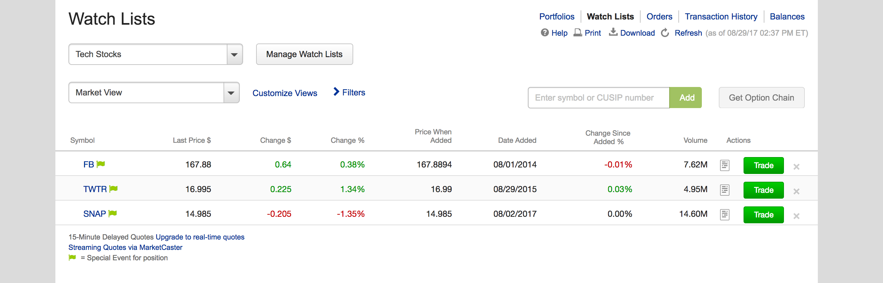
Customer Lifecycle
Consideration
Evaluation
Fund Account Opening
Experience & Transactions
Retention
Advocacy
Solution
Engaging With Your Customers (Adding Funds for Buy &Sell)
Set up automated and relevant Stock Information, Sensex info, Intra day Trade Alert, Buy/Sell Alert, Square off Alert & IPO campaigns , e.g. if a user is trading a stock, show them stock price range, industry report, Quarter results info via Push, Email.
We can determine the day trade and stop loss price for stock buying based on user’s product with buy and sell benchmark for intra day trading, FnO, Derivatives, IPO
Providing value-added services enhances users’ experience and increases their stickiness.
Nudge users who have opted for “Price Alerts” for the next few days with messages such as - “Price drop Alerts. Price range Buy/Sell Now. Nudge them for Webinars and Advocacy for Trading.
Market Update
Range Bound trade was witnessed in Nifty throughout the FnO Expiry day,closed @ 10779, upto 49 points
TATA power trading at 300 -400. Ensuring Bullish market
Book Now
Channel of Communication
Hey Ravi, We know you’ll love this!
Refer your friends to open an account with ABC and get:
Wallet Voucher worth Rs.500/-* on each successful account referred.
— Journey, Web-Push, Email, SMS, Push, In-app and On-site
Improvement Expected
~15%
Improvement in Conversions
Booked Order value of h 10 stocks in the last 24 hours

Slide 27
Customer Lifecycle
Consideration
Evaluation
Fund Account Opening
Experience & Transactions
Retention
Advocacy
Problem
Engaging With Your Customers (Post Transaction)
At this stage, the user makes a transaction. Here buy-sell , order value and other product opportunities are maximum
Goal
Increase order value revenue & different product, understand customer preferences. Improve brand recall with user

Slide 28

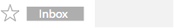
Customer Lifecycle
Consideration
Evaluation
Fund Account Opening
Experience & Transactions
Retention
Advocacy
Solution-1
As soon as the transaction is done, send the user an Email and SMS with booking details, Order Value and Portfolio
Engage with the users in the interim between their two transaction date with vital information, on a timely basis
Examples:
AM-TRAVL
Hey Ravi buy TCS at X price. Check the company result and book 5 stocks to reap profits
4.00 PM
Hey Ravi,
Congratulations, your booking of stocks are confirmed! Details here.
Real-time content in the emailers about the availability of new stocks & trends of companies for users to evaluate and transact. The price map will be real time at the time of sending the email.
Persuade users for Priority transaction & company results timely emails highlighting the convenience factor, user can experience
Here are the few investment products available for you.
Select now!
SIP with minimum of 5000 with low risk and high returns
ABC IPO plans at a band of 500-600 and book maximum profit
Hey Ravi, your selected stocks price has increased..Book now! To gain profit
Channel of Communication
— Journey, Web-Push, Email, SMS, Push
CLICK HERE
Improvement Expected
~15%
Improvement in Conversions
Check

Slide 29
Customer Lifecycle
Consideration
Evaluation
Fund Account Opening
Experience & Transactions
Retention
Advocacy
Problem
Streamline Referral Program
Customer may Trade once and may never return or may not spread the word about their experience
Goal
Get customer to refer people they know to trade online from the Trading company, Encourage them to leave feedback

Slide 30

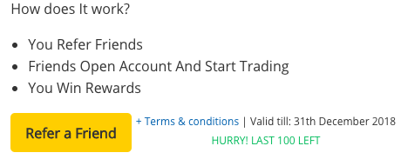
Flight
Customer Lifecycle
Consideration
Evaluation
Fund Account Opening
Experience & Transactions
Retention
Advocacy
Solution
Incentivise the user with a chance to earn cashback in their e-wallet every time they refer a friend as well as on their first transaction
The communication can be sent in a recursive manner, to get users to keep making referrals
Gift Vouchers/Rewards can be offered for every referral.
Hey Ravi,
Good news for you! Now refer a friend and get Rs.500* Gift voucher on successful account referred!
Your Unique Referral Code is TRN1465
Channel of Communication
You & your friend both will get Rs.5,00
BrokerageCashback*
— Journey, Web-Push, Email, SMS, Push
Improvement Expected
~07%
Increase in Online Traffic
Know More

Slide 31


[Case-study] How DSP BlackRock Increased Email Open rate by 39% & CTOR by 9% With Hyper-personalized Emails putting 6912 variations
39
%
increase in
Email Open Rate

Slide 32
How DSP BlackRock Increased Conversions by 11% With Hyper-personalized Emails
DSP is India’s Leading Mutual Fund Investment company
The Objective
Online mutual fund face a persistent problem of timely information flow to existing users who bought mutual funds.
The Marketing Team at DSP BlackRock wanted to engage these ‘existing customers’ with hyper-personalised communication, aimed at informing them.
We helped them create this highly personalised and dynamic email template with 6912 variations
Here’s a link to the full case-study
The content of the email was dynamically decided based on the user’s data.
Adding Logic to the email, and accordingly the HTML blocks were sent via Journey

Slide 33




How DSP BlackRock Increased Conversions by 11% With Hyper-personalized Emails
DSP is India’s Leading Mutual Fund Investment company
Key Result
DSP BlackRock experienced an increase of 39% in their email open rates & 9% CTOR - within a month of implementing WebEngage!
DSP BlackRock helped to bridge the knowledge gap among investors about the various options and even, how their own fund is performing. One of the primary objectives of the digital arm of DSP BlackRock is to keep nurturing the customers. Cross-selling is a big opportunity and this hyper – personalised email aims to accomplish the same.
Here’s a link to the full case-study.
How WebEngage helps reduce Search Abandonment
Several investors doesn’t get timely information, so no cross sell
WebEngage Journey gets hyper personalized logic based email template variation
User receives hyper-personalised email with real time data
Increase in Retention and Conversion Rate

Slide 34




Happy to Help!
Here are a few very helpful resources that we are happy to share with you.
Resources
Case Studies
Developer Docs

